Slide 1
A Simple Quiz
For LMS Testing

Slide 2


What is 1 + 1?
A) 2
B) 0
C) 40
Correct - Click anywhere to continue
Incorrect - Click anywhere to continue
Your answer:
You answered this correctly!
You did not answer this question completely
The correct answer is:
You must answer the question before continuing
Submit
Clear

Slide 3
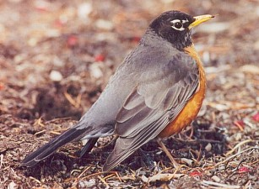
True or False, a Robin is a type of bird.
A) True
B) False
Correct - Click anywhere to continue
Incorrect - Click anywhere to continue
Your answer:
You answered this correctly!
You did not answer this question completely
The correct answer is:
You must answer the question before continuing
Submit
Clear

Slide 4

Complete the sentence below by filling in the blank.
3-2=
Correct - Click anywhere to continue
Incorrect - Click anywhere to continue
Your answer:
You answered this correctly!
You did not answer this question completely
The correct answer is:
You must answer the question before continuing
Submit
Clear

Slide 5
Match the color to the fruit.
Column 1
Column 2
B
Red
A.
Blueberry
A
Blue
B.
Apple
C
Yellow
C.
Banana
Correct - Click anywhere to continue
Incorrect - Click anywhere to continue
Your answer:
You answered this correctly!
You did not answer this question completely
The correct answer is:
You must answer the question before continuing
Submit
Clear

Slide 6
Indicate how strongly you agree or disagree with the following statements.
Disagree
Somewhat Disagree
Neutral
Somewhat Agree
Agree
This course was useful
This is a good product
This is working with my LMS
Submit
Clear

Slide 7
Is there anything else you'd like to let us know?
Your answer:
You answered this correctly!
You did not answer this question completely
The correct answer is:
Submit
Clear

Slide 8
Quiz
Your Score | {score}
Max Score | {max-score}
Number of Quiz Attempts | {total-attempts}
Question Feedback/Review Information Will Appear Here
Continue
Review Quiz

